Slide 1
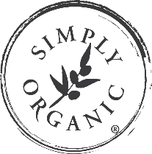
Wonderful World of Retail:
O&M Care
+ Treatments
54 O&M STYLE BIBLE

Slide 2

We’ve thought hard for hair. The root cause of bad hair days is STRESS. So we’re calling time on the chemical overload.
Our mission is to challenge the artificial norms of professional hair care with the message that HEALTHY hair begins when it’s stress free.
‘Use Your Head’ is our motto.
O&M: Bridging the gap between natural and luxury.

Slide 3

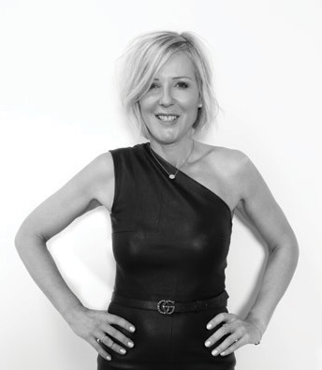

At Original & Mineral,
Our vision is to bring nature and luxury together in a line of Australia-born hair color, care and styling products that are safe, effective and beautiful to use.
Now, with the help of world-leading chemists, we’ve evolved again.
The world is changing, and low-chemical and natural technology is leading the way.
Replacement of harsh chemicals with active natural extracts.
In 2010, I added O&M Method, our care and styling line.
No harmful sulphates, parabens, propylene glycol, MIT or Triclosan.
Certified by PETA as Cruelty Free
O&M CØR.color = Progressive new technology called MBT (Molecular Blend Technology)
Original & Mineral is a complete salon solution, made for hairdressers by hairdressers. We’re a band of rule-breakers and pioneers, committed to making the world safer and more beautiful – and having fun while we do it. We’d love you to join us.
Jose Bryce Smith
CEO & Founder
4

Slide 4
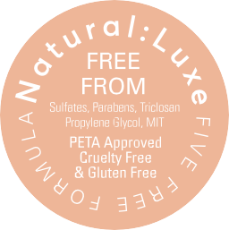

Natural: Luxe
AUSTRALIAN MADE

Slide 5
SOCIAL MEDIA
HASHTAGS
INSTAGRAM
#OriginalMineral
#CØRcolor
#HolisticHairTribe
@OriginalMineral
@SimplyOrganicOfficial
@Waynetec
Follow us!

Slide 6
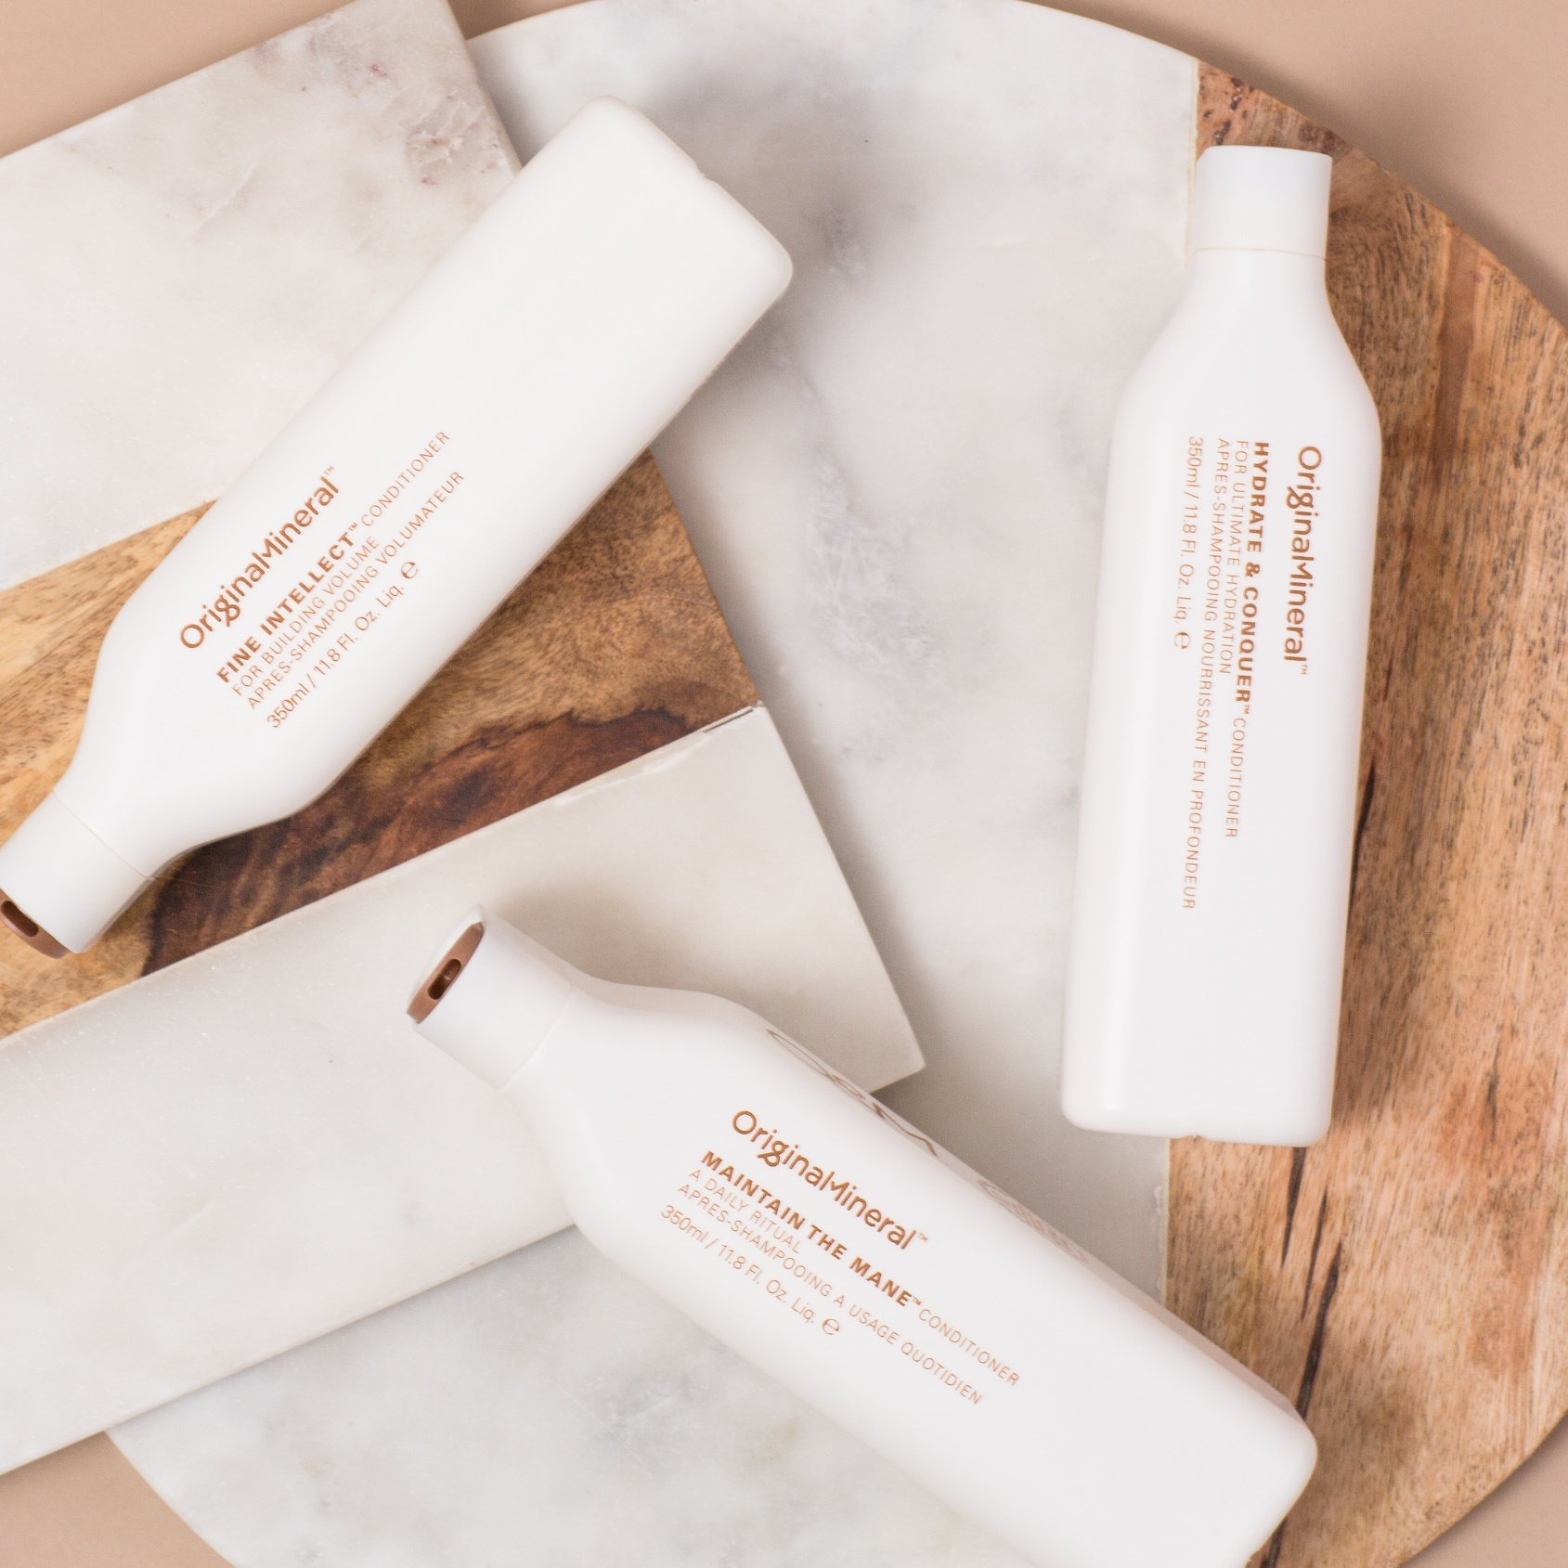
THE O&M THREE STEP METHOD
As our cleansers do not contain harsh chemicals, we have created an O&M Method to achieve the perfect clean hair.
STEP 1
DETOX
The first step is to remove buildup and residues to prepare the hair for the treatment. Use
O&M DETOX SHAMPOO as your gentle surface exfoliant.
STEP 2
CLEANSE
Treat the hair with a texture-specific cleanser. O&M FINE INTELLECT, O&M MAINTAIN THE MANE, O&M HYDRATE & CONQUER or O&M CONQUER BLONDE.
STEP 3
MOISTURIZE
To seal the deal, moisturize the hair. Best products for this step are O&M FINE INTELLECT, O&M MAINTAIN THE MANE, O&M HYDRATE & CONQUER, O&M SEVEN DAY MIRACLE, O&M POWER BASE, or O&M CONQUER BLONDE.

Slide 7
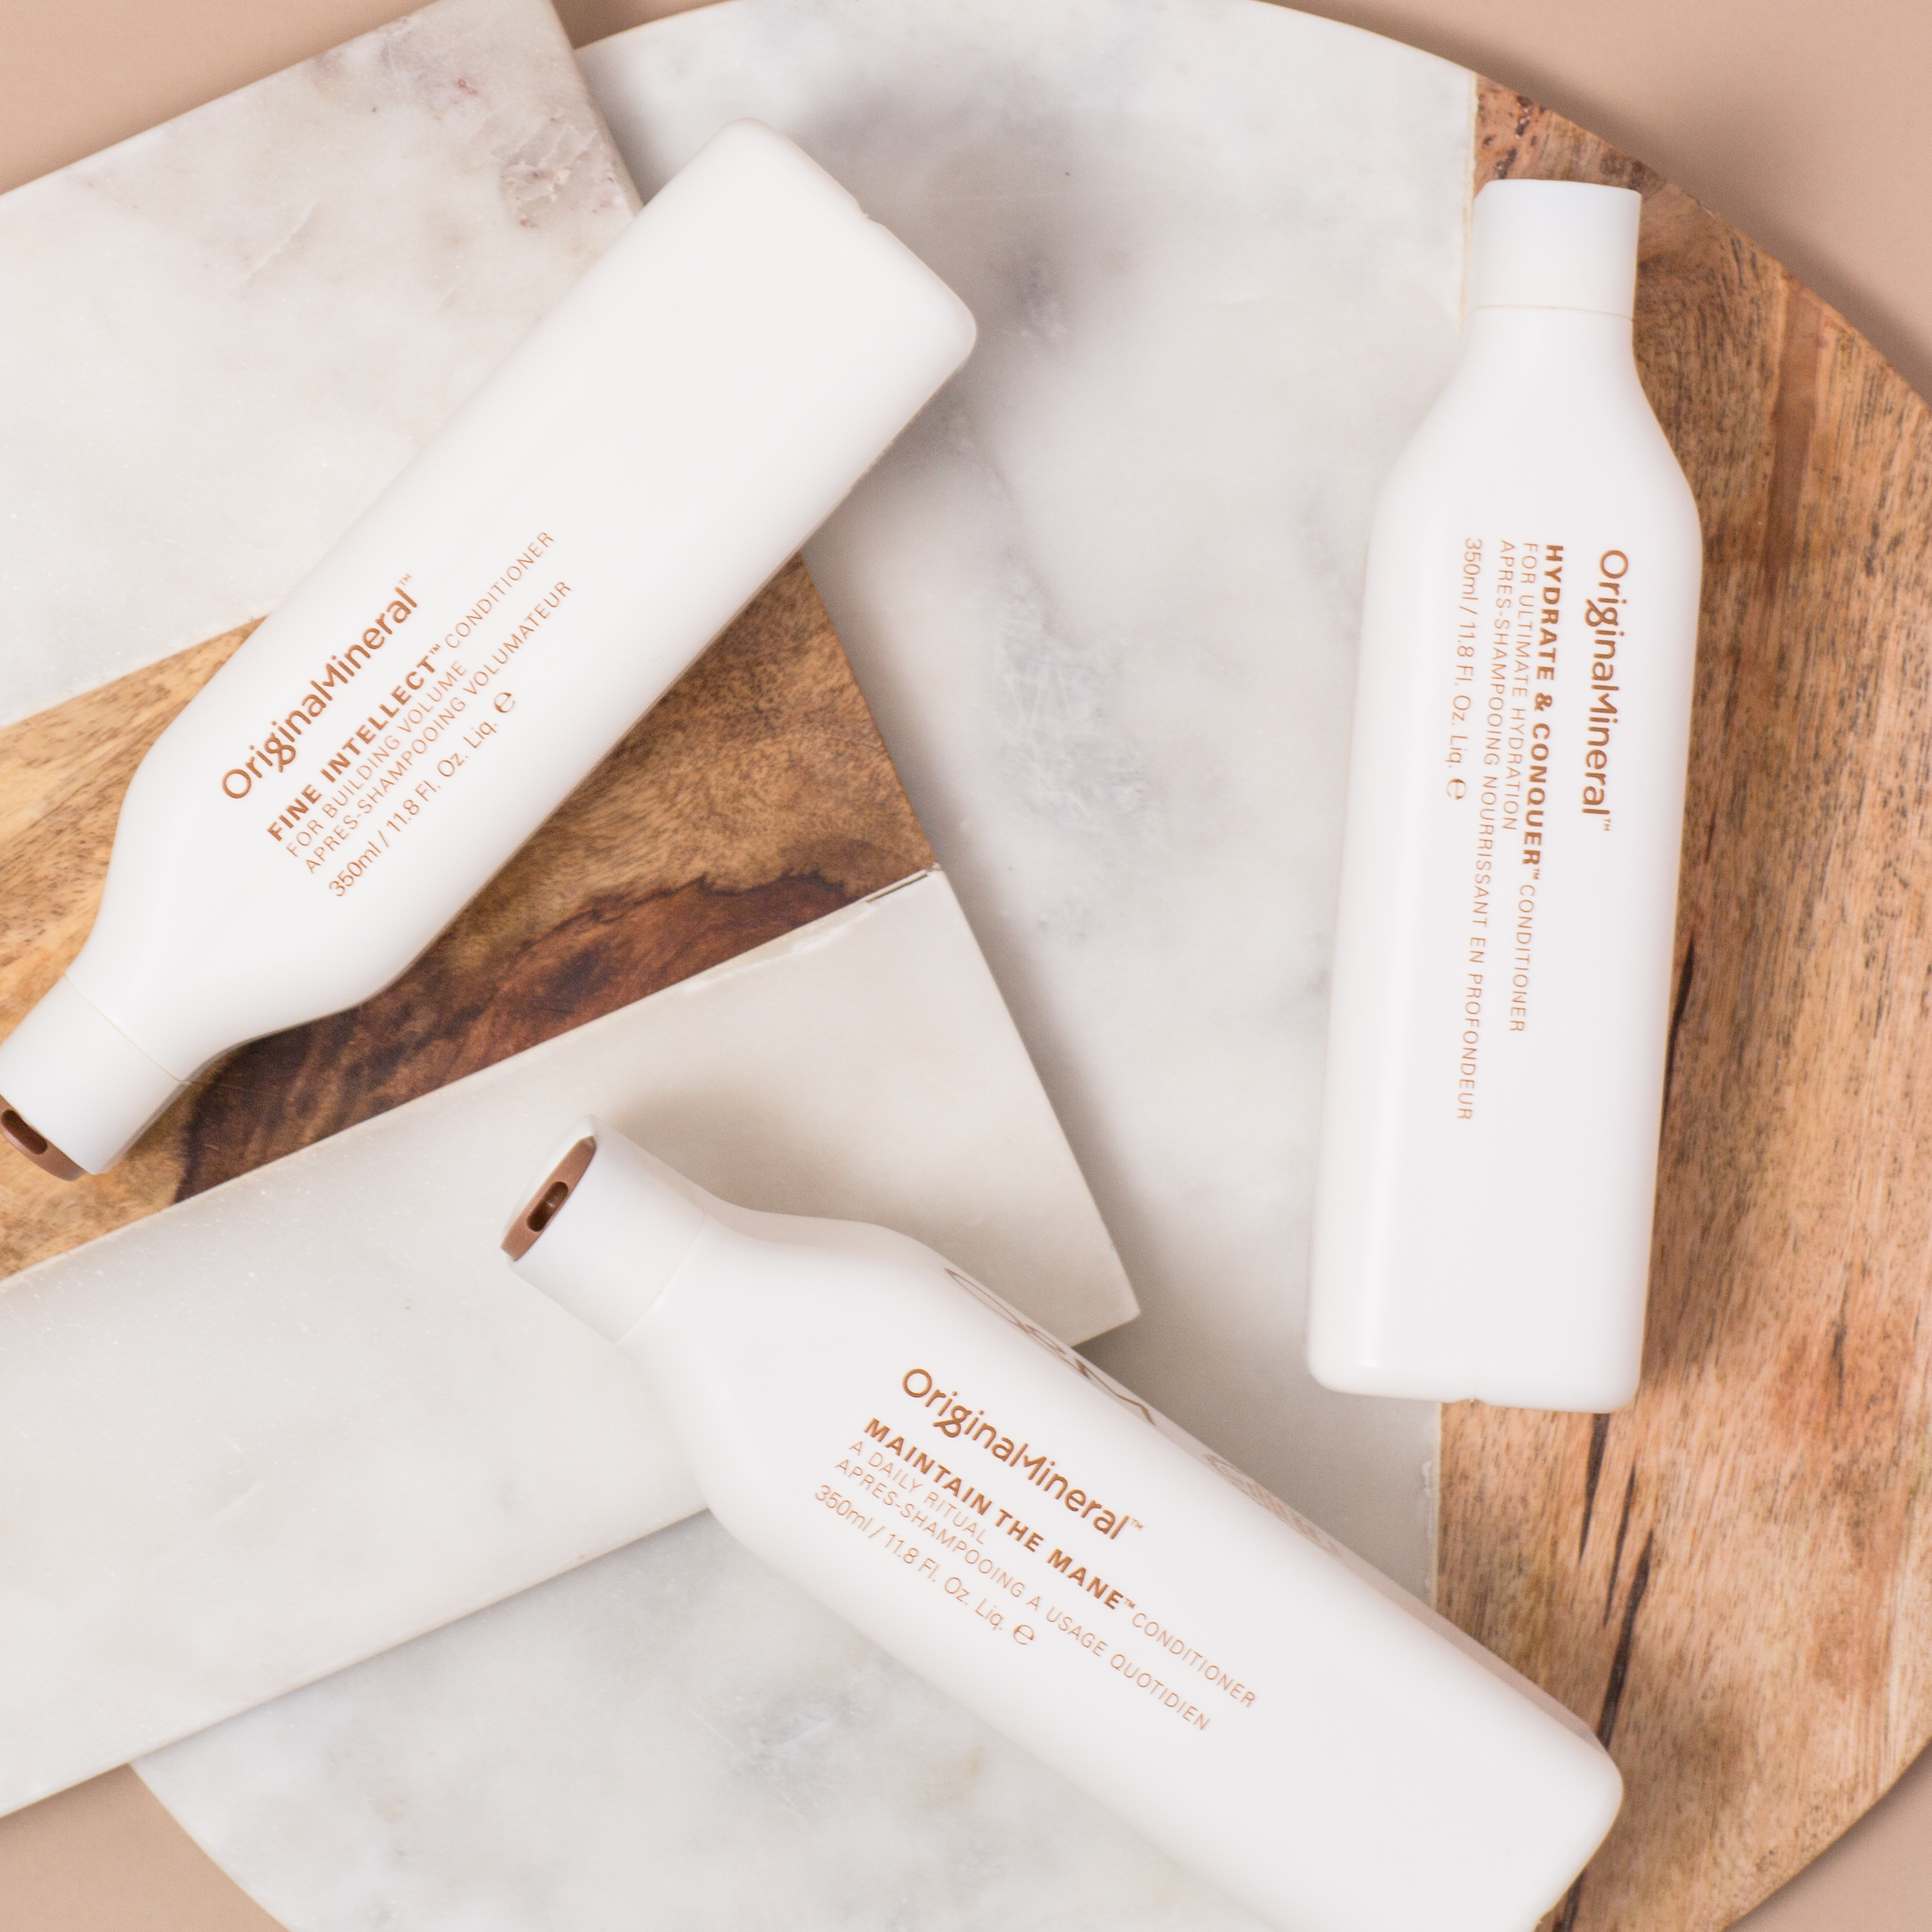
CARE

Slide 8
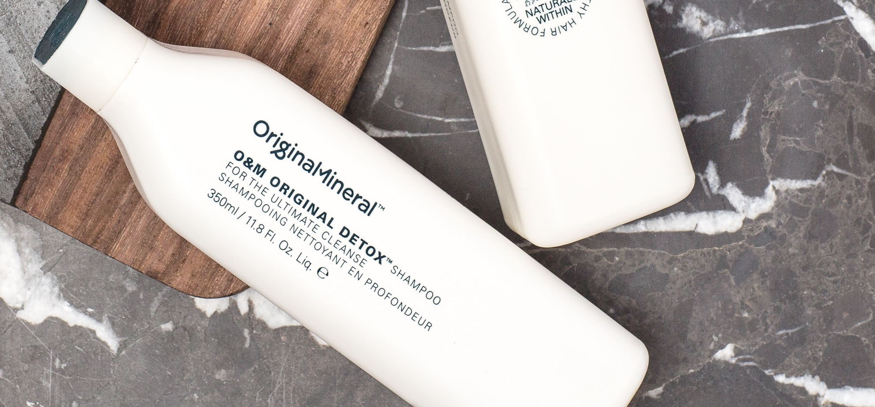
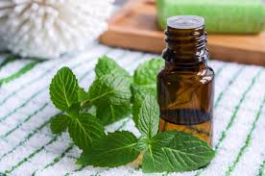
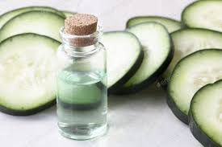
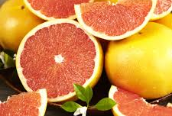
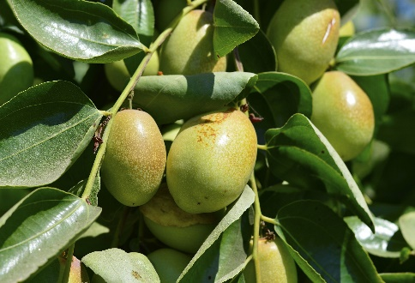
DETOX
SHAMPOO
pH 4.5 – 5.5
WHAT IS IT
Deep cleansing shampoo to remove impurities, mineral deposits, and build-up of styling products and chlorine without stripping away the hair’s natural oils. – color safe.
HOW TO USE
After wetting hair, apply liberally and massage before rinsing. For a deep cleanse, leave on hair for 5 minutes. Rinse and follow with conditioning treatment.
WHAT’S POWERING IT
Peppermint Oil
A natural oil that stimulates the hair and scalp while providing an invigorating and cooling effect.
Cucumber & Grapefruit
A natural plant extract rich in vitamin C and antioxidants that helps prevent aging.
Jojoba Esters
Naturally derived from Jojoba oil, the esters help in retaining color and help prevent fading.

Slide 9
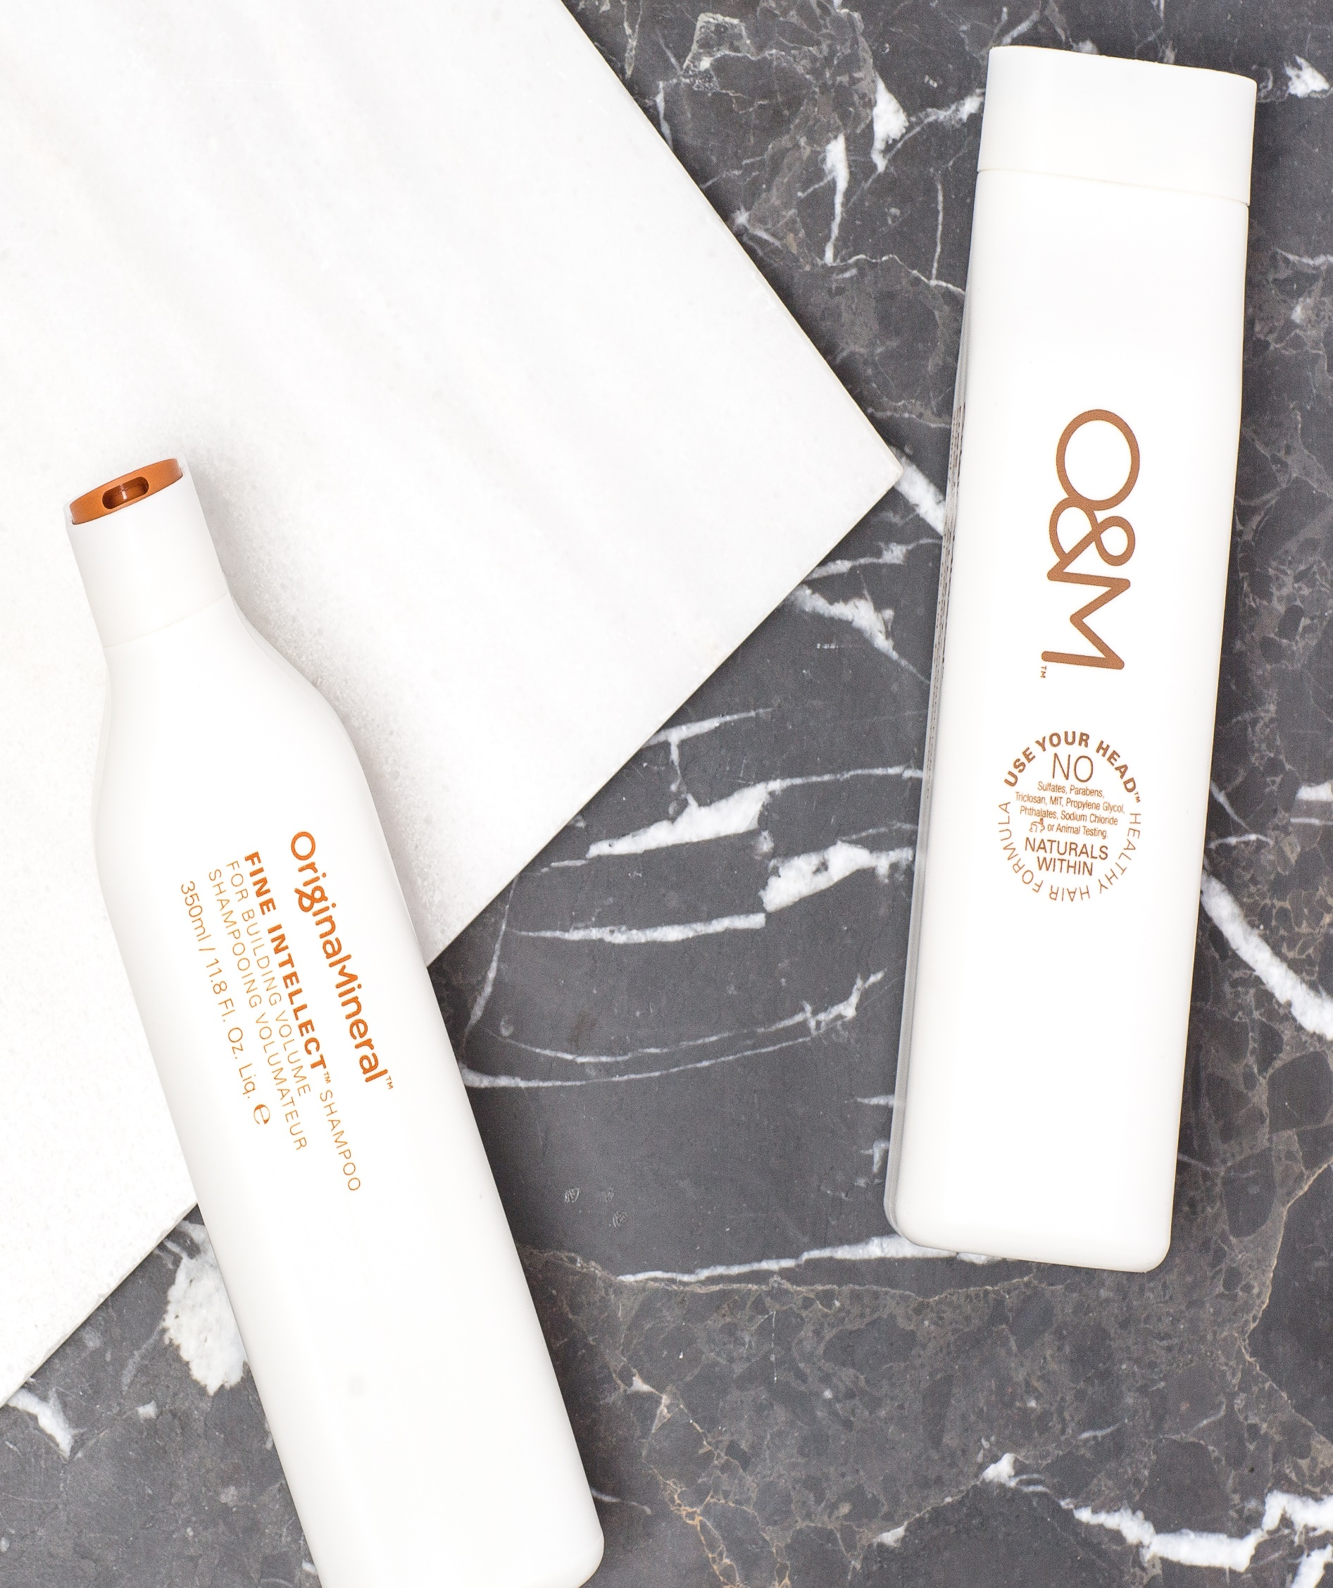
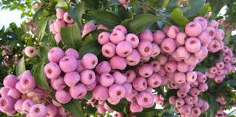
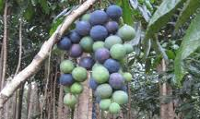
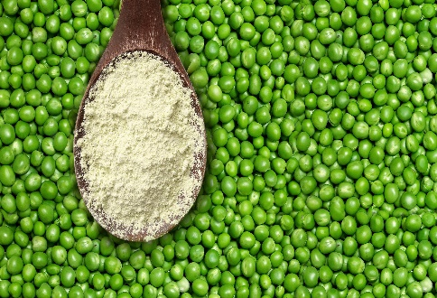
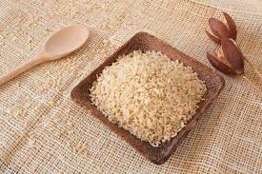
FINE INTELLECT
SHAMPOO
pH 4.5 – 5.7
WHAT IS IT
Building volume into lightweight hair. Formulated to pump up hair from the roots.
HOW TO USE
After wetting hair, apply liberally and massage before rinsing. Follow up with suggested conditioning treatment.
WHAT’S POWERING IT
Lilly Pilly
A native Australian plant extract ingredient very high in vitamin C that acts as a natural collagen, plumping the hair.
Davidsonia Plum
A natural plant extract from the Australian rainforest that helps protect hair from oxidization and sun damage.
Keratin
A natural building block for hair, Keratin helps to repair hair damage, fight frizz and protect strands.
Rice Protein
A natural protein that adds softness and mobility while it strengthens the hair for continued damage repair and prevention.

Slide 10

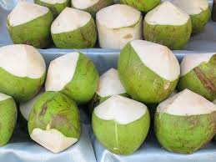
FINE INTELLECT
CONDITIONER
pH 4.5 – 5.5
WHAT IS IT
Building volume into lightweight hair. Formulated to pump up hair from the roots.
HOW TO USE
After shampooing, remove access water and apply Fine Intellect Conditioner. Massage through mid-lengths and ends working upward. Comb through, rinse and proceed with styling.
WHAT’S POWERING IT
Lilly Pilly
A native Australian plant extract ingredient very high in vitamin C that acts as a natural collagen, plumping the hair.
Davidsonia Plum
A natural plant extract from the Australian rainforest that helps protect hair from oxidization and sun damage.
Keratin
A natural building block for hair, Keratin helps to repair hair damage, fight frizz and protect strands.
Coco-Caprylate
A coconut oil derived moisturizer and detangling agent that adds smoothness and luster to the hair.

Slide 11
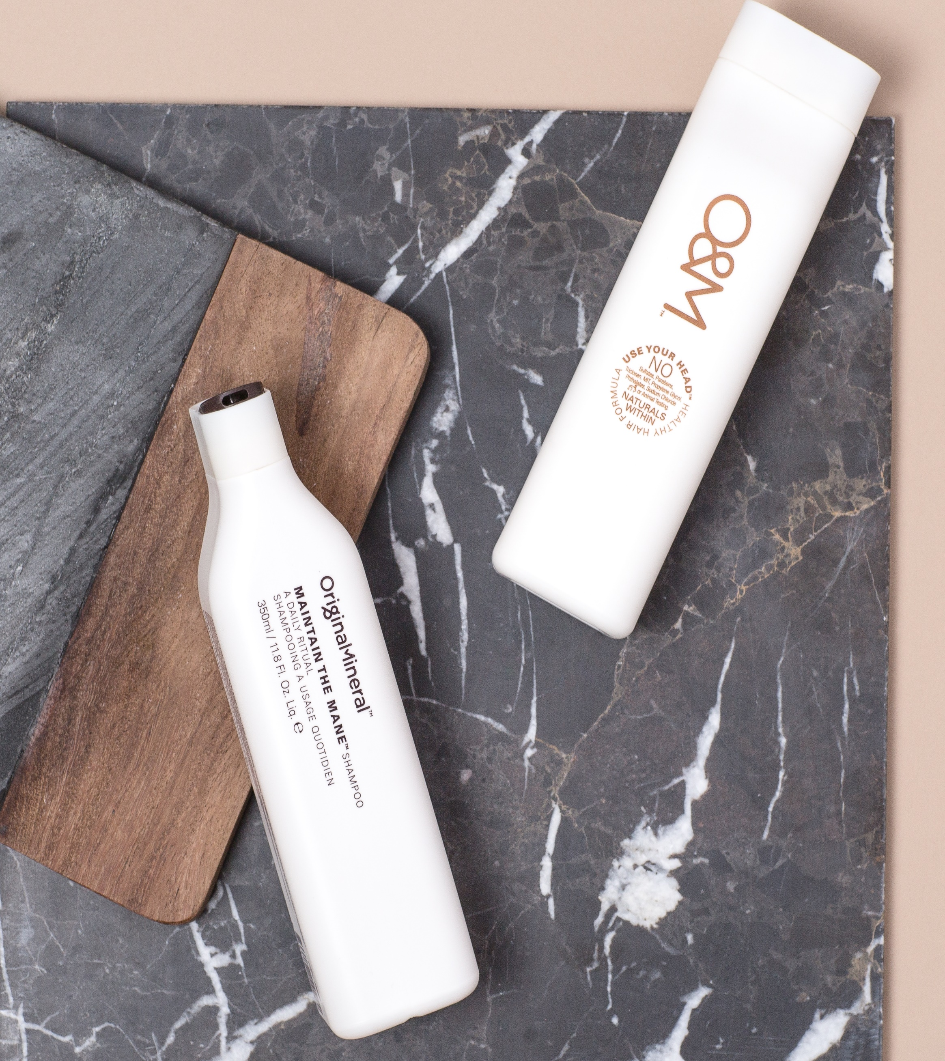
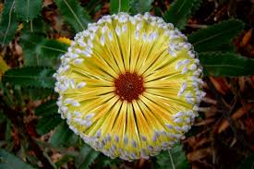
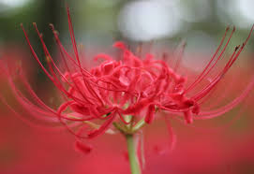
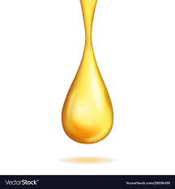
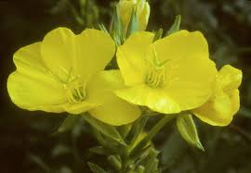
MAINTAIN THE MANE
SHAMPOO
pH 4.5 – 5.7
WHAT IS IT
Best for daily use. Has the perfect balance of moisture to not add weight.
HOW TO USE
Apply liberally to wet hair. Massage into scalp, rinse and follow up with suggested conditioning treatment.
WHAT’S POWERING IT
Banksia
A native Australian tree extract that is rich in antioxidants and amino acids.
Red Spider Flower
A native Australian flower extract that helps to nourish and revitalize hair.
Pro-Vitamin B5
Shields colored hair from UV damage to guard against color fade.
Evening Primrose Oil
A natural oil that helps to add moisture and maintain the condition of the hair.

Slide 12

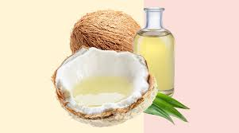
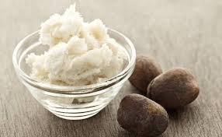
MAINTAIN THE MAIN
CONDITIONER
pH 4.5 – 5.5
WHAT IS IT
Gentle and nourishing, making it the perfect everyday conditioner to leave hair moisturized and shiny.
HOW TO USE
After shampooing, remove access water and apply Maintain the Mane. Massage through mid-lengths and ends working upward. Comb through, rinse and proceed with styling.
WHAT’S POWERING IT
Banksia
A native Australian tree extract that is rich in antioxidants and amino acids.
Red Spider Flower
A native Australian flower extract that helps to nourish and revitalize hair.
Organic Coconut Oil
A natural superfood that provides the ultimate hydration boost as well as superior detangling.
Shea Butter
A natural butter that is designed to soften and hydrate the hair.

Slide 13
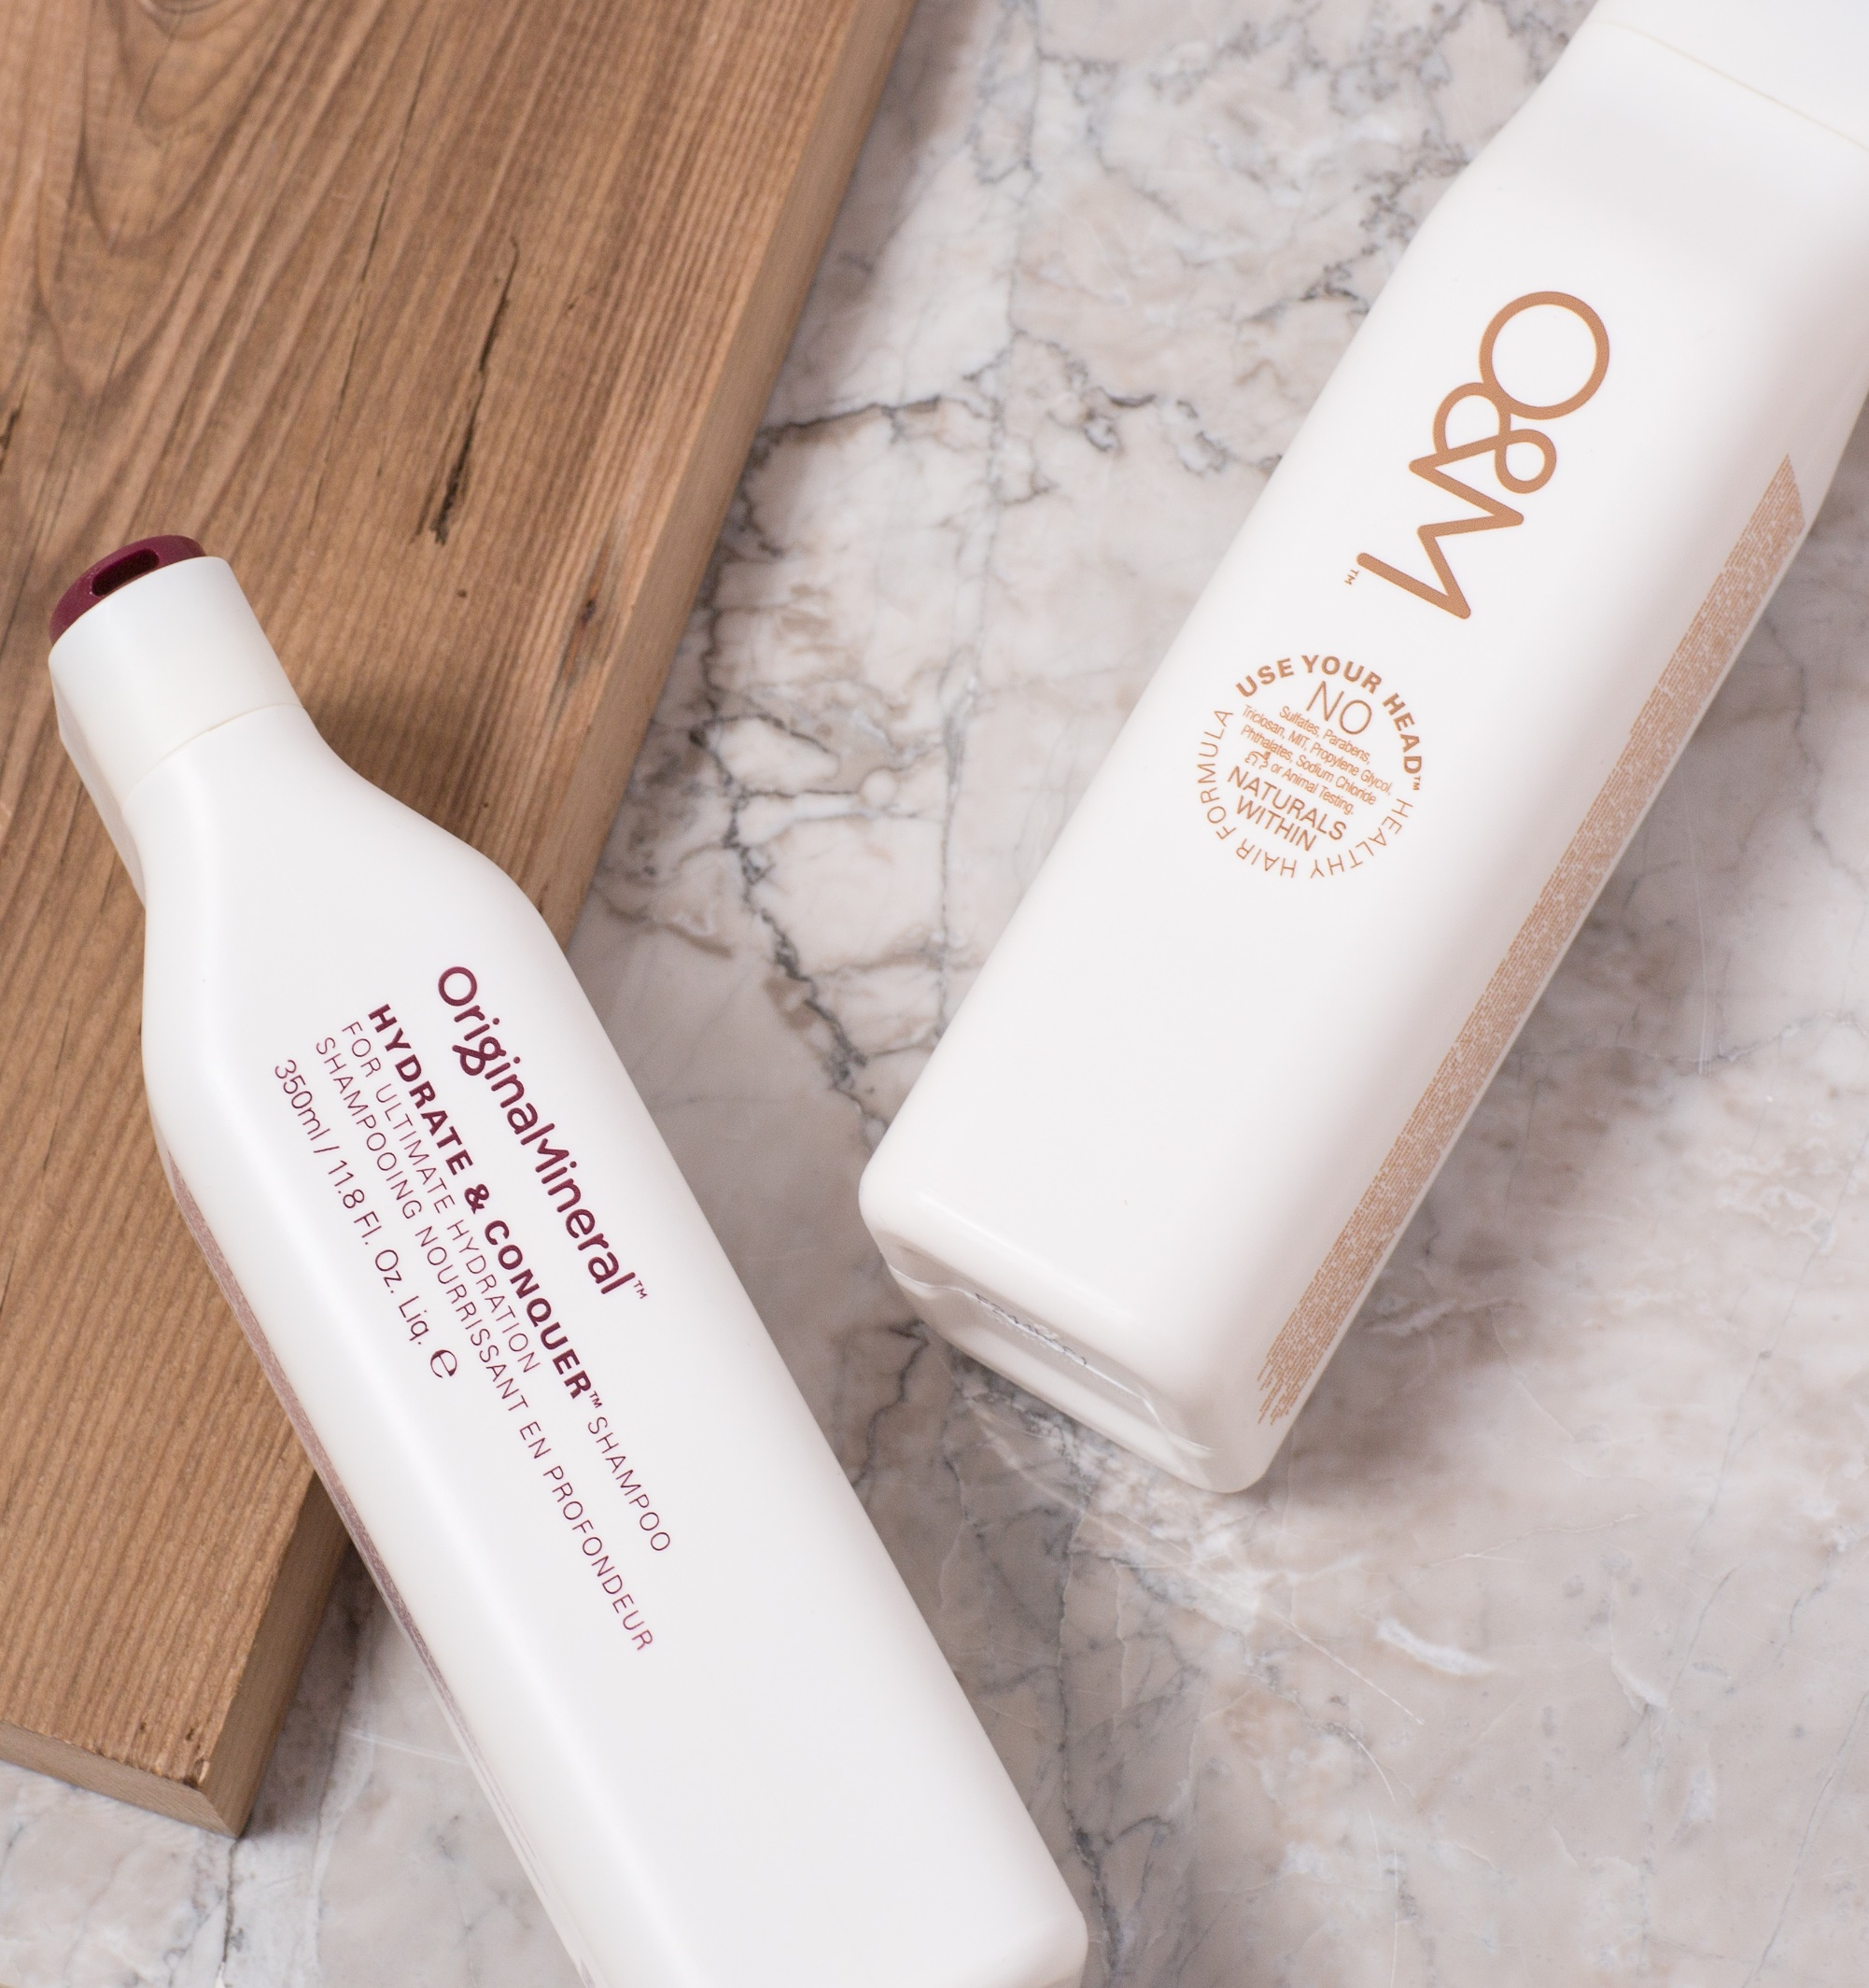
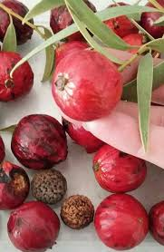
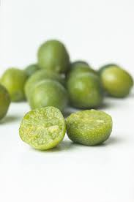
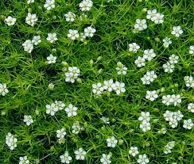
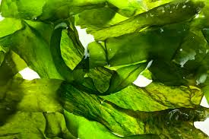
HYDRATE & CONQUER
SHAMPOO
pH 4.5 – 5.7
WHAT IS IT
Hydrating shampoo to add moisture to dry, thick, damaged, chemically treated or colored hair.
HOW TO USE
Apply liberally to wet hair. Massage into scalp, rinse and follow up with suggested conditioning treatment.
WHAT’S POWERING IT
Quandong
Naturally derived Australian desert plant extract high in vitamin C, proteins and essential fatty acids. Keeps the hair healthy and nourished.
Desert Lime
A natural antioxidant that helps fight free radicals and prevent premature aging.
Irish Moss Extract
A deeply hydrating natural moisturizer.
Tasmanian Sea Kelp
A plant extract packed with vitamins and amino acids to help repair the hair.

Slide 14

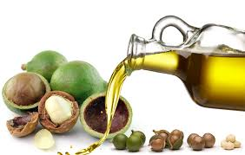
HYDRATE & CONQUER
CONDITIONER
pH 4.3 – 5.3
WHAT IS IT
Moisture rich conditioner best for dry, thick or damaged hair.
HOW TO USE
After shampooing, remove access water and apply Hydrate & Conquer Conditioner. Massage through mid-lengths and ends working upward. Comb through, rinse and proceed with styling.
WHAT’S POWERING IT
O&M Signature Oil Blend
A natural blend of organic coconut and organic macadamia oils that help to recondition the hair to protect it and leave it glossy and knot free.
Quandong
Naturally derived Australian desert plant extract high in vitamin C, proteins and essential fatty acids. Keeps the hair healthy and nourished.
Desert Lime
A natural antioxidant that helps fight free radicals and prevent premature aging.
Tasmanian Sea Kelp
A plant extract packed with vitamins and amino acids to help repair the hair.

Slide 15
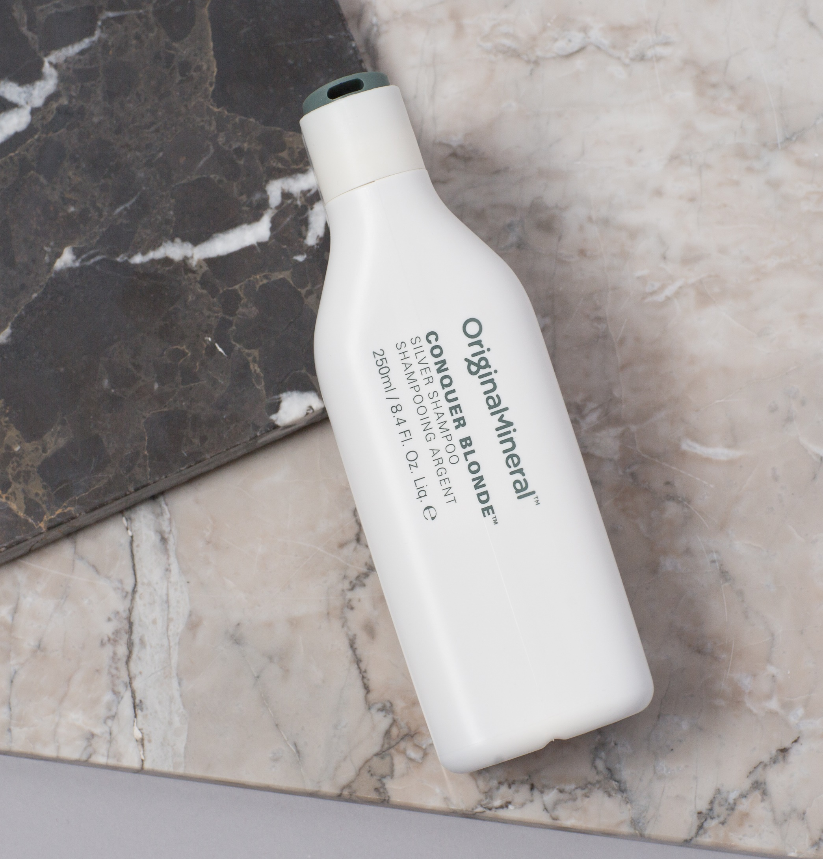
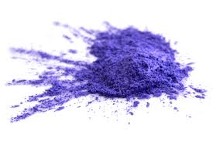
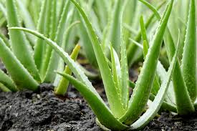
CONQUER BLONDE
SHAMPOO
pH 4.5 – 5.5
WHAT IS IT
Silver shampoo that helps remove dull yellow tones. Great for blondes and natural grey hair, banishing brassy tones and refreshing color..
HOW TO USE
Massage into wet hair and leave-in a minimum of 2 minutes. For a more intense result, leave-in up to 5 minutes and rinse.
WHAT’S POWERING IT
Violet Pigment
A color shine molecule that is designed to help remove brassiness from blonde and silver hair.
Desert Lime
A natural antioxidant that helps fight free radicals and prevent premature aging.
Aloe Vera
A plant extract that naturally softens and hydrates the hair.
Jojoba Esters
Naturally derived from Jojoba oil, the esters help retain color and prevent fading.

Slide 16
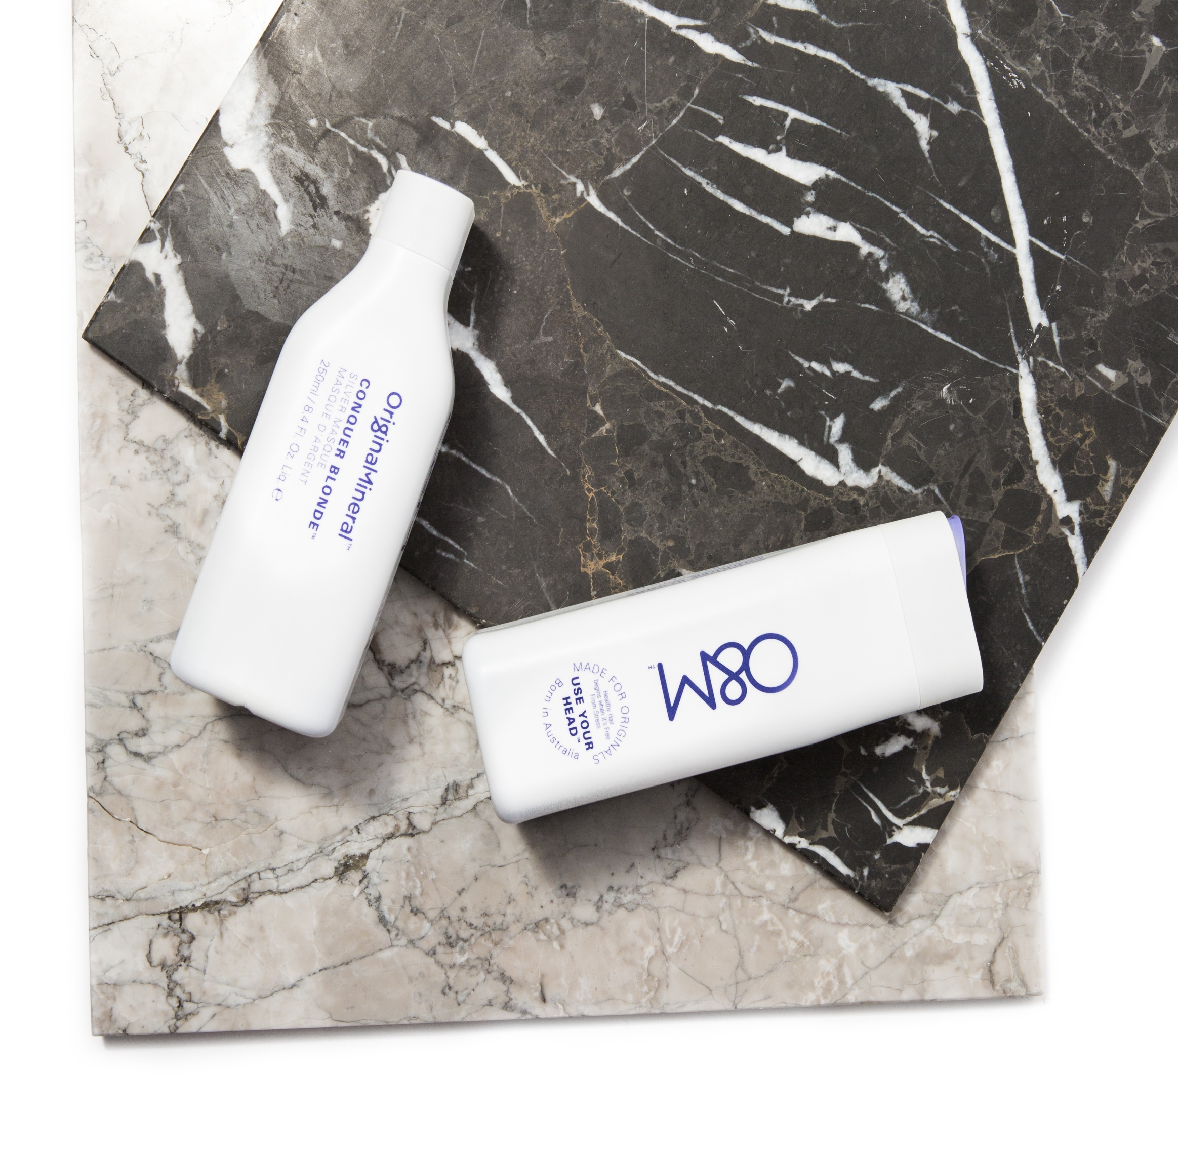
CONQUER BLONDE
MASQUE
pH 4.3 – 5.3
WHAT IS IT
Silver masque to help remove yellow and brassy tones to bones and naturally silver hair.
HOW TO USE
Massage into mid-lengths and ends, leaving-in a minimum of 2 minutes to a maximum of 5 minutes for a more intense result. Rinse and proceed with styling.
WHAT’S POWERING IT
Violet Pigment
A color shine molecule that is designed to help remove brassiness from blonde and silver hair.
O&M Signature Oil Blend
A natural blend of organic coconut and organic macadamia oils that help to recondition the hair to protect it and leave it glossy and knot free.
Quandong
Naturally derived Australian desert plant extract high in vitamin C, proteins and essential fatty acids. Keeps the hair healthy and nourished.
Shea Butter
A natural butter that is designed to soften and hydrate the hair.

Slide 17
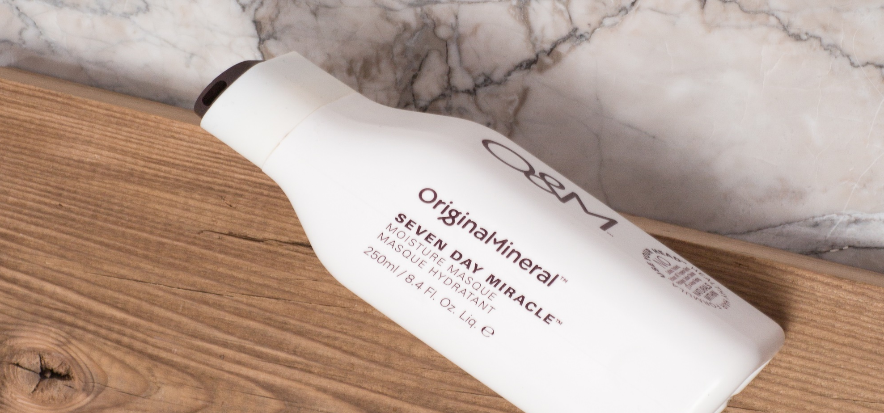
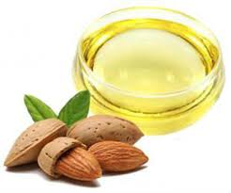
SEVEN DAY MIRACLE
MOISTURE MASQUE
pH 4.0 – 5.0
WHAT IS IT
Intense repairing moisture masque that nourishes extremely dry hair that may be damaged by coloring or heat agents.
HOW TO USE
Massage into wet hair and leave-in a minimum of 2 minutes. For a more intense result, leave-in up to 5 minutes and rinse.
WHAT’S POWERING IT
O&M Signature Oil Blend
A natural blend of organic coconut and organic macadamia oils that help to recondition the hair to protect it and leave it glossy and knot free.
Quandong
Naturally derived Australian desert plant extract high in vitamin C, proteins and essential fatty acids. Keeps the hair healthy and nourished.
Desert Lime
A natural antioxidant that helps fight free radicals and prevent premature aging.
Shea Butter
A natural butter that is designed to soften and hydrate the hair.
Sweet Almond Oil
A color shine molecule that is designed to help remove brassiness from blonde and silver hair.

Slide 18

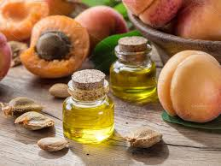
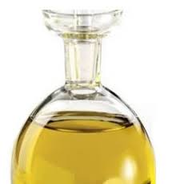
THE POWER BASE
PROTEIN MASQUE
pH 4.6 – 5.6
WHAT IS IT
Protein rich masque to help repair damaged, weak hair. Helps to infuse healing proteins into the hair.
HOW TO USE
Massage into wet hair and leave-in a minimum of 2 minutes. For a more intense result, leave-in up to 10 minutes, rinse and proceed with styling
WHAT’S POWERING IT
Apricot Kernel Oil
A natural oil that helps to nourish the hair and combat frizz.
Rice Protein
A natural protein that helps to strengthen the hair and boost fullness and growth.
Shea Butter
A natural butter that is designed to soften and hydrate the hair.
Vitamin E
An intense antioxidant and moisturizing oil.

Slide 19

HASHTAGS
#OriginalMineral
#CØRcolor
#HolisticHairTribe
Distributed by
Simply Organic Beauty
INSTAGRAM
@OriginalMineral
@SimplyOrganicOfficial
@Waynetec
54 O&M STYLE BIBLE

